Slide 1
Student Information Management System
(SIMS)

Slide 2
Our Group & How We Created SIMS
Team Model: Modern Hierarchical
Kirk Registe- Connect VB
Rohan Thaliachery- Creating database and MySQL
Jon Viesca- Creating the GUI
Jake Sceroler- Creating UML, documentation
Devindrasinh Varachhia- Connect VB, Team Leader

Slide 3
How We Created SIMS
Visual Basic to create Graphical User Interface in Visual Studio
MySQL for database management system
Other software/applications: MS Excel, MS Visio, draw.io, ARGO UML

Slide 4
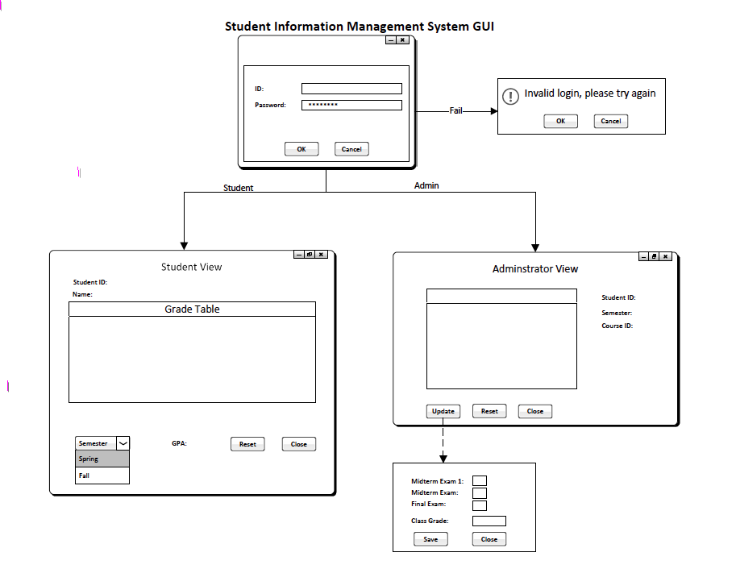
UML Diagrams

Slide 5
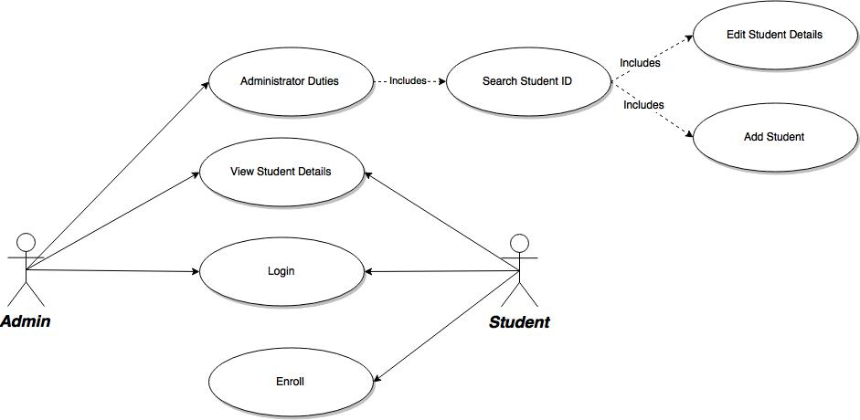
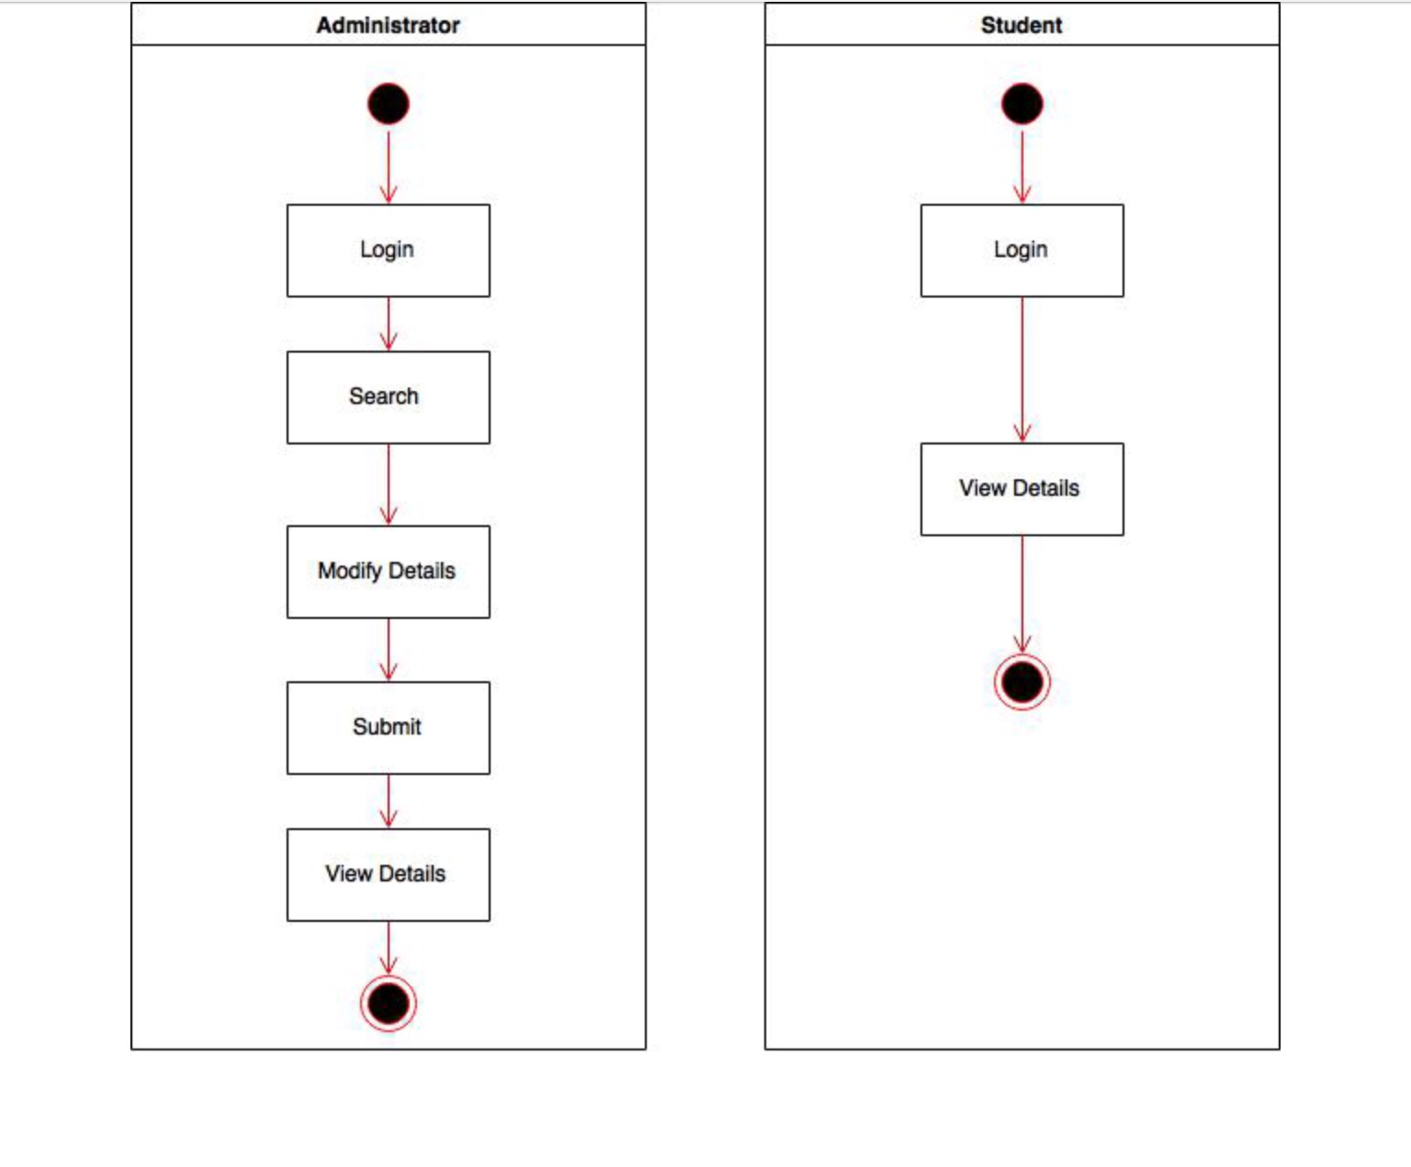
UML Diagrams Cont.

Slide 6
Database
Create Four tables in MySQL
O Student Information
O Course Information
O Scheduling Information
O Grading Information

Slide 7
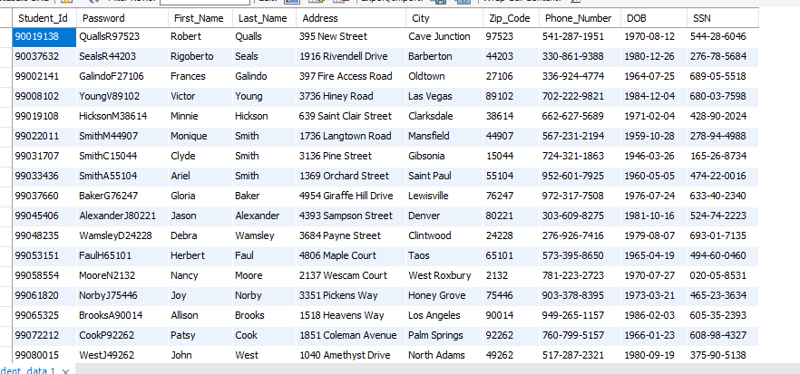
Database Example - Student Information

Slide 8
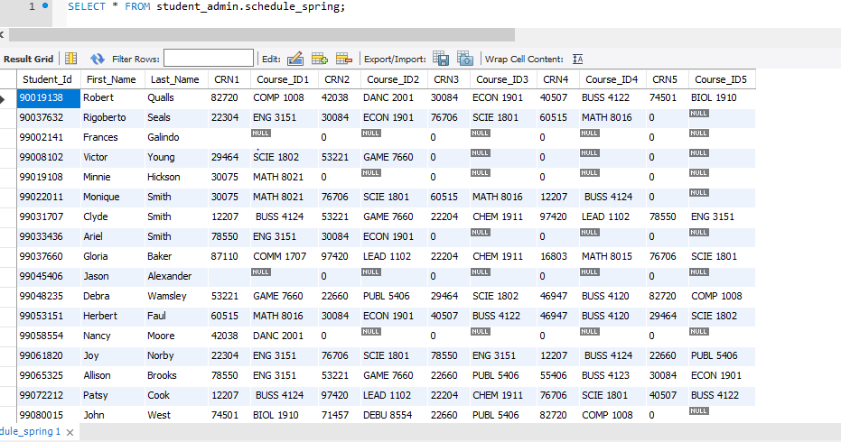
Database Example- Schedule

Slide 9
GUI
Admin View
Login Form - Accepts Admin Username and Password
Grades Form - Allows Admin to View Grades/ Search for Students
Update Form - Allows Admin to Update Grades
Student View
Login Form - Accepts Student Username and Password
Grades Form - Students’ ID, Course Information and Grades are Shown

